Slide 1
Enhanced Entity-Relationship (EER) Modeling

Slide 2
Topics Covered
EER stands for Enhanced ER or Extended ER
EER Model Concepts
Includes all modeling concepts of basic ER
Additional concepts:
subclasses/superclasses
specialization/generalization
categories (UNION types)
attribute and relationship inheritance

Slide 3
Subclasses and Superclasses
An entity type may have additional meaningful subgroupings of its entities
Example: EMPLOYEE may be further grouped into SECRETARY, ENGINEER, MANAGER, TECHNICIAN, SALARIED_EMPLOYEE, HOURLY_EMPLOYEE,…
Each of these groupings is a subset of EMPLOYEE entities
Each is called a subclass of EMPLOYEE
EMPLOYEE is the superclass for each of these subclasses
These are called superclass/subclass relationships.
Example: EMPLOYEE/SECRETARY, EMPLOYEE/TECHNICIAN

Slide 4
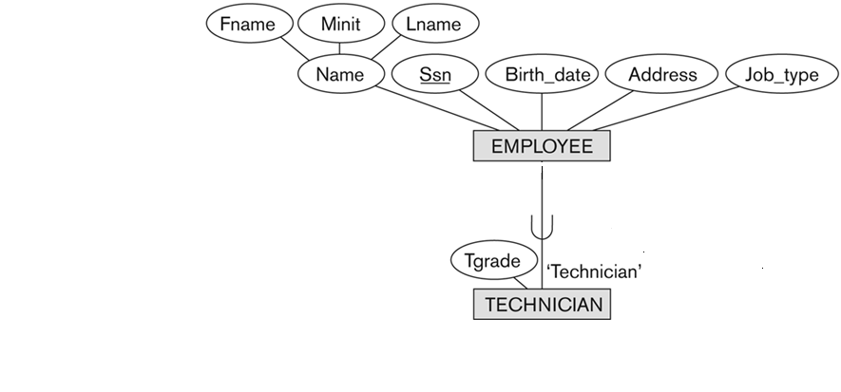
Super class and Subclass

Slide 5
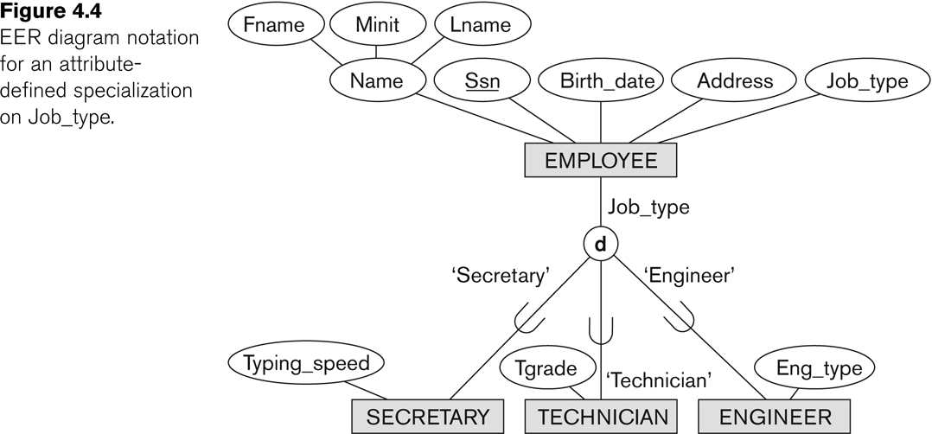
Representing Specialization in EER Diagrams

Slide 6
These are also called “IS-A” relationship
Members of a subclass must be members of the superclass
SECRETARY IS-A EMPLOYEE, TECHNICIAN IS-A EMPLOYEE, ….
address
id
birthday
Movie Person
name
ISA
picture
Actor
Director

Slide 7
Subclasses, Superclasses and Inheritance
An important concept associated with subclasses is that of type inheritance
An entity that is member of a subclass inherits
All attributes of the entity as a member of the superclass
All relationships of the entity as a member of the superclass

Slide 8
Subclasses, Superclasses and Inheritance
Example:
In the previous slide, SECRETARY (as well as TECHNICIAN and ENGINEER) inherit the attributes Name, SSN, …, from EMPLOYEE
Every SECRETARY entity will have values for the inherited attributes
Every SECRETARY entity will also keep all relationships

Slide 9
Entity Type Inheritance
Type Inheritance among Classes
Inherited Attributes
a subclass inherits the attributes of the superclass
HOURLY_EMPLOYEE (Name, SSN, Address)
Local (Specific) Attributes
a subclass may have its own attributes
HOURLY_EMPLOYEE (Hourly_rate)
SALARIED_EMPLOYEE (Annual_salary)

Slide 10
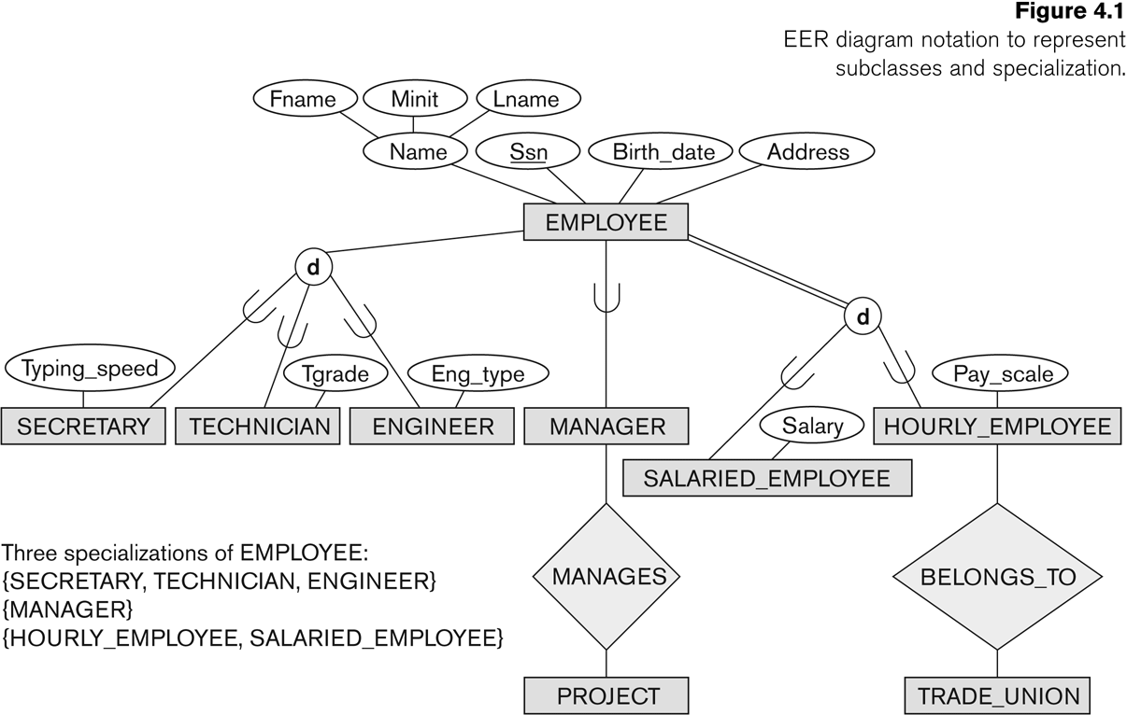
Subclasses and Superclasses
Specific Attribute
Specific relationship type

Slide 11
Specialization and Generalization
Specialization
Process of defining subclasses of an entity type (superclass)
Defined on the basis of some distinguishing characteristics of the entities in the superclass.
A (super)class ⇒ a set of subclasses
Method of pay {SALARIED_EMPLOYEE,HOURLY_EMPLOYEE}
Job type {SECRETARY, ENGINEER, TECHICIAN}
Why specialization
Attributes applied to some but not all entities
Only members of the subclass participate in a specific relationship type

Slide 12
Generalization
The reverse of the specialization process
Several classes with common features are generalized into a superclass; original classes become its subclasses
Example: CAR, TRUCK generalized into VEHICLE; both CAR, TRUCK become subclasses of the superclass VEHICLE.
We can view {CAR, TRUCK} as a specialization of VEHICLE
Alternatively, we can view VEHICLE as a generalization of CAR and TRUCK

Slide 13
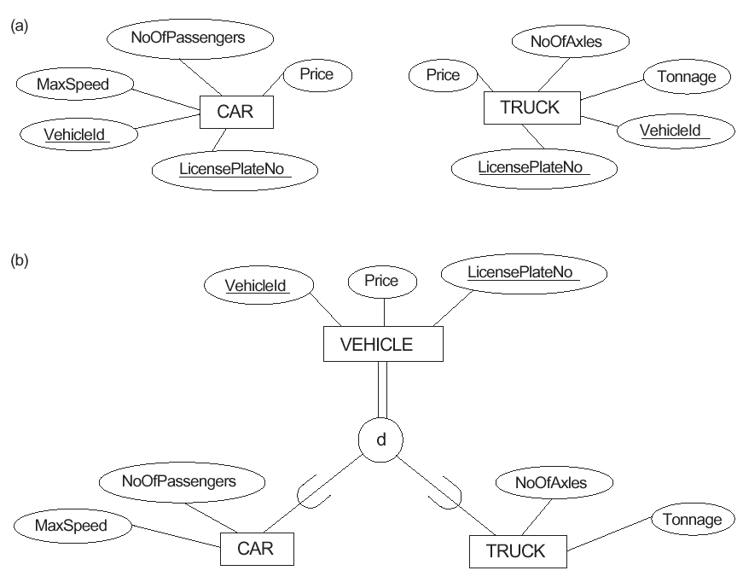
Figure 4.3 Examples of generalization. (a) Two entity types CAR and TRUCK. (b) Generalizing CAR and TRUCK into VEHICLE.

Slide 14
GENERALIZATION & SPECIALIZATION
student
sid
name
Generalization
is A
Specialization
Undergrad
graduate

Slide 15
Constraints on Specialization and Generalization
Two basic constraints can apply to a specialization/generalization:
Disjointness Constraint:
Completeness Constraint:

Slide 16
Constraints on Specialization and Generalization
Disjointness Constraint:
Specifies that the subclasses of the specialization must be disjoint: an entity can be a member of at most one of the subclasses of the specialization
Specified by d in EER diagram

Slide 17
Displaying an attribute-defined specialization in EER diagrams

Slide 18
Constraints on Specialization and Generalization
If not disjoint, specialization is overlapping:
that is the same entity may be a member of more than one subclass of the specialization
Specified by o in EER diagram

Slide 19
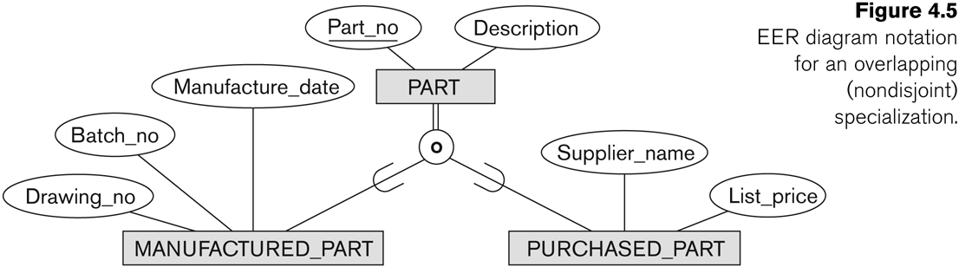
Example of overlapping total Specialization

Slide 20
Constraints on Specialization and Generalization
Completeness Constraint:
Total specifies that every entity in the superclass must be a member of some subclass in thes pecialization/generalization
Shown in EER diagrams by a double line
Partial allows an entity not to belong to any of the subclasses
Shown in EER diagrams by a single line
In general, a superclass that was identified through the generalization process usually total, because the superclass is derived from the subclasses and hence contains only the entities that are in the subclass

Slide 21
Constraints on Specialization and Generalization
If all subclasses in a specialization have membership condition on same attribute of the superclass, specialization is called an attribute defined-specialization
Attribute is called the defining attribute of the specialization
Example: JobType is the defining attribute of the specialization {SECRETARY, TECHNICIAN, ENGINEER} of EMPLOYEE
Use defined
User identifies how the subclasses are formed

Slide 22
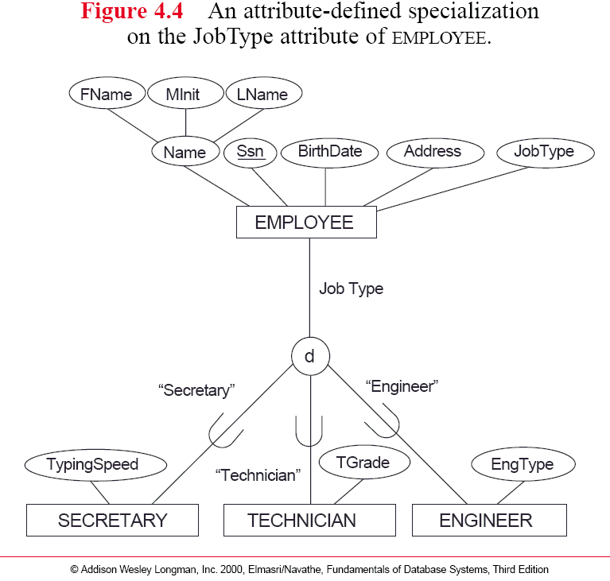
Constraints for Specialization and Generalization
Defining
attribute
Predicate condition
Predicate-defined
subclass

Slide 23
Union
All of the superclass/subclass relationships we have seen so far origin from a single superclass
Sometimes we may need more than one superclass
In this case, the subclass will represent a collection of objects that is a subset of the UNION of distinct entity types
We call such a subclass a UNION TYPE

Slide 24
Union
Example: In a database for vehicle registration, a vehicle owner can be a PERSON, a BANK (holding a lien on a vehicle) or a COMPANY.
A UNION type called OWNER is created to represent a subset of the union of the three superclasses COMPANY, BANK, and PERSON

Slide 25
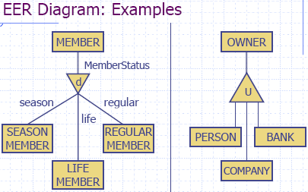

Slide 26
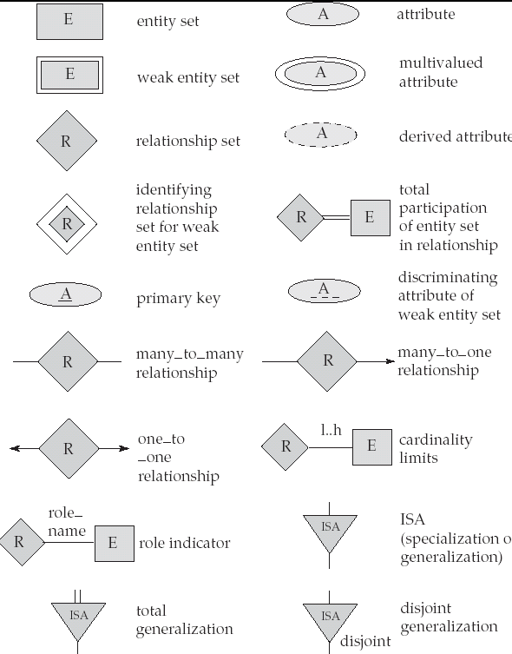
Summary of Symbols Used in E-R Notation

